Slide 1
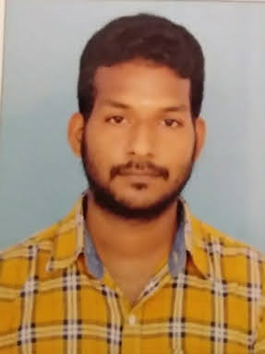
Madarapu Bapiraju
SELECTED EXPERIENCE
Application development analyst
Role :Unity developer
Phone : 9390991818
Email:madarapu.bapiraju@accenture.com
Having hands on experience on Altspace platform to show the features implemented for Metaverse using tools like Unity .
Creating the tasks and managing the Azure boards in azure portal.
Experience on Agile development methodology.
Hands on experience in building, designing and maintaining Cloud based applications with Azure.
As a DevOps& Cloud Engineer worked in Azure environment, to deploy and manage the Azure services like Virtual Machines, Web Apps,Storage accounts, using PowerShell and Terraform
Maintaining ,branching and tagging the versions across the environments using SCM tool GitHub.
Implemented CI/CD pipelines using Azure DevOps.
Worked on version control systems like GIT and used source code management client tools like Gitlab.
Worked on Docker containers, attaching to a running container, removing images, managing containers.
Pic
SKILLS
Technologies like NodeJS, MRE,Typescript.
Tools like Unity.
Cloud services of Microsoft Azure.
Databases as Microsoft SQL Server and Postgres
CI/CD Tools of Jenkins.
Tracking tools as JIRA.
CERTIFICATIONS
AZ-900:Microsoft Azure Fundamentals(2022)
AZ-400:Designing and Implementing Microsoft DevOps Solutions(2022)
PL-900 :Microsoft Power Platform Fundamentals(2022)
AZ-104 :Microsoft Azure Administrator(2022)

